Slide 1
Cross Validation

Slide 2
What is Cross Validation?
Cross-validation is a statistical method used to estimate the skill of machine learning models.
There is always a need to validate the stability of your machine learning model.
You just can’t fit the model to your training data and hope it would accurately work for the real data it has never seen before.
You need some kind of assurance that your model has got most of the patterns from the data correct, and its not picking up too much on the noise, or in other words its low on bias and variance.

Slide 3
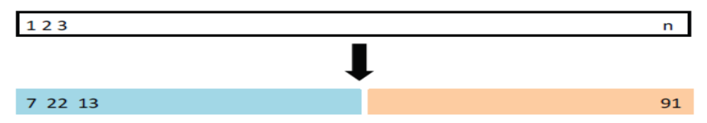
Validation set approach
Goal: Estimate the test error for a supervised learning method.
Strategy:
Split the data in two parts.
Train the method in the first part.
Compute the error on the second part.

Slide 4
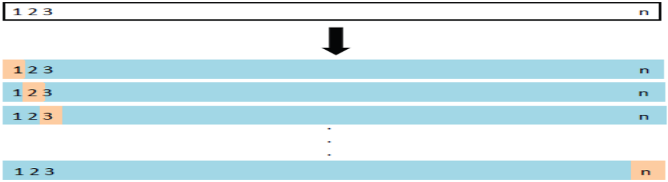
Leave one out cross-validation
1. For every i = 1, . . . , n:
1.1 train the model on every point except i,
1.2 compute the test error on the held out point.
2. Average the test errors.

Slide 5
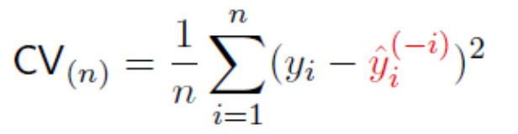
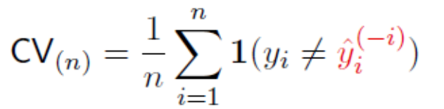
Leave one out cross-validation
1. For every i = 1, . . . , n:
1.1 train the model on every point except i,
1.2 compute the test error on the held out point.
2. Average the test errors.
for a regression problem.
for a classification problem.
Prediction for the i sample without using the ith sample.

Slide 6
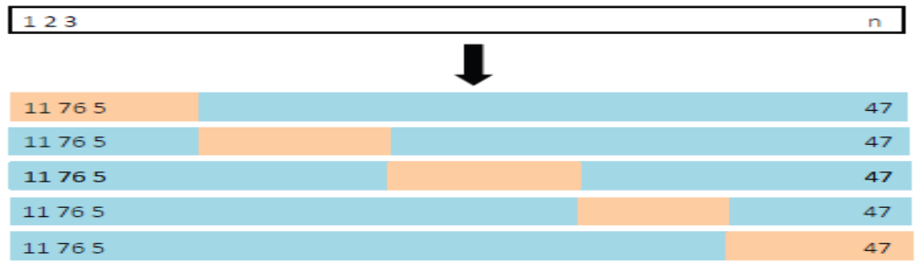
k-fold cross-validation
1. Split the data into k subsets or folds.
2. For every i = 1, . . . , k:
2.1 train the model on every fold except the ith fold,
2.2 compute the test error on the ith fold.
3. Average the test errors.

Slide 7
Variations on Cross-Validation
There are a number of variations on the k-fold cross validation procedure. Three commonly used variations are as follows:
Train/Test Split: Taken to one extreme, k may be set to 1 such that a single train/test split is created to evaluate the model.
LOOCV: Taken to another extreme, k may be set to the total number of observations in the dataset such that each observation is given a chance to be the held out of the dataset. This is called leave-one-out cross-validation, or LOOCV for short.
Stratified: The splitting of data into folds may be governed by criteria such as ensuring that each fold has the same proportion of observations with a given categorical value, such as the class outcome value. This is called stratified cross-validation.

Slide 8
Cross-Validation API
We do not have to implement k-fold cross-validation manually. The scikit-learn library provides an implementation that will split a given data sample up.
class sklearn.model_selection.KFold(n_splits, shuffle, random_state)
Parameters
n_splits: int, default=5
Number of folds. Must be at least 2.
shuffle:bool, default=False
Whether to shuffle the data before splitting into batches. Note that the samples within each split will not be shuffled.
random_state: int, RandomState instance or None, default=None
When shuffle is True, random_state affects the ordering of the indices, which controls the randomness of each fold. Otherwise, this parameter has no effect. Pass an int for reproducible output across multiple function calls.

Slide 9
Cross-Validation API
We do not have to implement k-fold cross-validation manually. The scikit-learn library provides an implementation that will split a given data sample up.
class sklearn.model_selection.KFold(n_splits, shuffle, random_state)
# scikit-learn k-fold cross-validation
from numpy import array
from sklearn.model_selection import KFold
# data sample
data = array([0.1, 0.2, 0.3, 0.4, 0.5, 0.6])
# prepare cross validation
kfold = KFold(3, True, 1)
# enumerate splits
for train, test in kfold.split(data):
print('train: %s, test: %s' % (data[train], data[test]))
train: [0.1 0.4 0.5 0.6], test: [0.2 0.3]
train: [0.2 0.3 0.4 0.6], test: [0.1 0.5]
train: [0.1 0.2 0.3 0.5], test: [0.4 0.6]

Slide 10
Cross-Validation API: Example for random state
-----> if random_state = None : Calling the function multiple times will produce different results.
-----> if random_state = Integer : Will produce the same results across different calls
X = np.array([[1, 2], [3, 4], [1, 2], [3, 4],[5,6],[7,8],[9,10],[11,12],[13,14]])
y = np.array([1, 2, 3, 4,5,6,7,8,9])
kf = KFold(n_splits=3,random_state=None, shuffle=True)
for train_index, test_index in kf.split(X):
print("TRAIN:", train_index, "TEST:", test_index)
TRAIN: [0 1 2 4 6 8] TEST: [3 5 7]
TRAIN: [1 2 3 5 7 8] TEST: [0 4 6]
TRAIN: [0 3 4 5 6 7] TEST: [1 2 8]
TRAIN: [2 4 5 6 7 8] TEST: [0 1 3]
TRAIN: [0 1 3 5 6 7] TEST: [2 4 8]
TRAIN: [0 1 2 3 4 8] TEST: [5 6 7]
kf = KFold(n_splits=3,random_state=1, shuffle=True)
for train_index, test_index in kf.split(X):
print("TRAIN:", train_index, "TEST:", test_index)
TRAIN: [0 1 3 4 5 7] TEST: [2 6 8]
TRAIN: [2 3 4 5 6 8] TEST: [0 1 7]
TRAIN: [0 1 2 6 7 8] TEST: [3 4 5]
TRAIN: [0 1 3 4 5 7] TEST: [2 6 8]
TRAIN: [2 3 4 5 6 8] TEST: [0 1 7]
TRAIN: [0 1 2 6 7 8] TEST: [3 4 5]

Slide 11
Stratified K-Folds cross-validator
Provides train/test indices to split data in train/test sets.
This cross-validation object is a variation of KFold that returns stratified folds. The folds are made by preserving the percentage of samples for each class.
from sklearn.model_selection import StratifiedKFold
X = np.array([[1, 2], [3, 4], [1, 2], [3, 4]])
y = np.array([0, 0, 1, 1])
skf = StratifiedKFold(n_splits=2)
skf.get_n_splits(X, y)
2
print(skf)
StratifiedKFold(n_splits=2, random_state=None, shuffle=False)
for train_index, test_index in skf.split(X, y):
print("TRAIN:", train_index, "TEST:", test_index)
X_train, X_test = X[train_index], X[test_index]
y_train, y_test = y[train_index], y[test_index]
TRAIN: [1 3] TEST: [0 2]
TRAIN: [0 2] TEST: [1 3]

